Slide 1
Northern District of Illinois Probation and Pretrial Services
New Chain of Custody Training
February 15, 2023

Slide 2
Why are we changing?
National Requirements from the Administrative Office of the U.S. Courts
Easier for Contract Service Providers and Lab Staff
Long-Term Planning

Slide 3
New forms and procedure
Effective March 1, 2023
Starting February 28, 2023, facilities will receive emailed PDFs with pre-populated chain of custody forms for the clients scheduled to report the following day.
It will be each facility’s responsibility to print the pre-populated chain of custody forms each day
Use of the ALERE chain of custody forms (Blue for Pretrial and Green for Probation) will not longer be permitted

Slide 4
Notable Changes
The new CoC forms are now half pages. Paper is perforated in middle for separating.
There is no longer a carbon copy for the collecting agency to obtain.
Security seal is now client’s initials (previously collector’s initials)

Slide 5
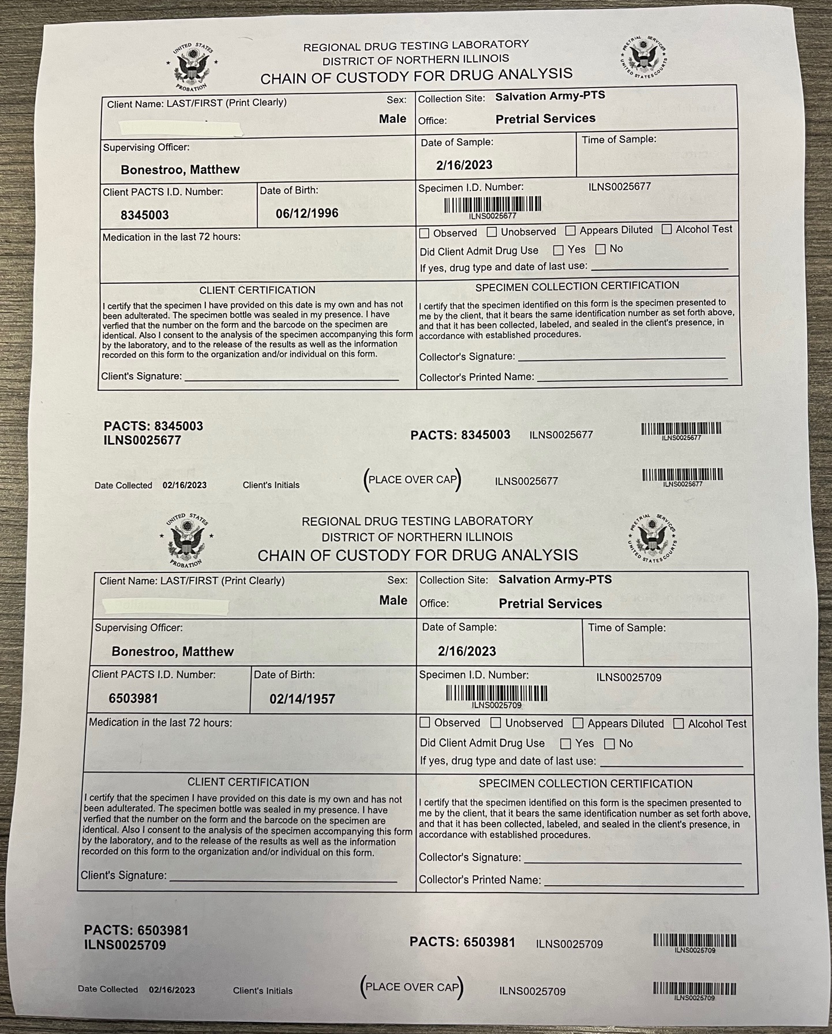
Image of CoC paper as it will be sent to contract service providers
Image of CoC paper after printing

Slide 6
Filling Out the chain of Custody
Chain of custody forms will include the following sections already pre-populated:
Client Name
Sex
Collection Site
Office
Supervising Officer
Date of Sample
PACTS Number
Client Date of Birth
Specimen ID # and Barcodes

Slide 7
Filling Out the chain of Custody
Facilities will be responsible for completing the following (circled in red):
Time of Sample
Medications in last 72 hours
Observed/Unobserved
Client Admit to Drug Use
Client Certification
Specimen Collection Certification
Client Initials on Barcode
Place security seal over lid of collected sample and affix label with PACTS No. and Specimen ID No. to side of bottle (circled in yellow)

Slide 8
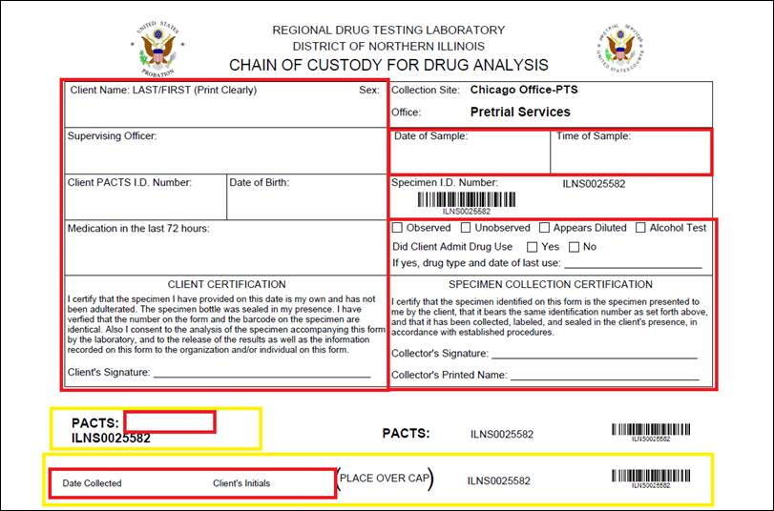
Barcode forms
These forms can be used in the event a defendant/person under supervision reports to your facility on short notice and a pre-populated form was not generated the night before. In these instances, the collector will need to hand write all other sections of the form. These chain of custody forms should only be used when a client is present at your facility, collection is authorized, and a pre-populated form is not available.
Confirm which agency’s form you are using before filling it out.

Slide 9
Packaging and Shipping Process
Please continue to place the completed chain of custody in the pocket separate from the collection cup to avoid potential contamination issues. Shipping requirements are not impacted by this change.
Nothing changes with shipping procedures or expectations.

Slide 10
Printing
Universal printing instructions cannot be provided due to the varying makes and models of printers. The Probation and Pretrial Services Offices recommend the following tips:
----------------------------------------------------------------------------------------------------------------------------------------------
Print the chain of custody forms from the same printer each day to insure consistent printing.
On March 1, 2023, print the chain of custody PDF on regular white paper to confirm how the chain of custody paper needs to be fed into the printer before printing with the chain of custody paper. You can handwrite “top”, “bottom”, “front”, and “back” on the blank paper before test printing to determine how the paper comes out of your make/model of printer. If still unsure, use the chain of custody paper but only print the first page to confirm the correct paper orientation.
Disable “Print on Both Sides” before printing.
Printing in black and white is acceptable

Slide 11
WARNING
DO NOT reuse previously sent chain of custody PDFs. Each email PDF generates new specimen ID numbers and barcodes. Reprinting old PDFs will cause problems with duplicate specimen ID numbers once the sample reaches our lab.

Slide 12
To order More Paper
INTAKE_BOP@ilnp.uscourts.gov
Can be used for blank CoC paper or Barcode CoCs

Slide 13
Questions???

